Slide 1
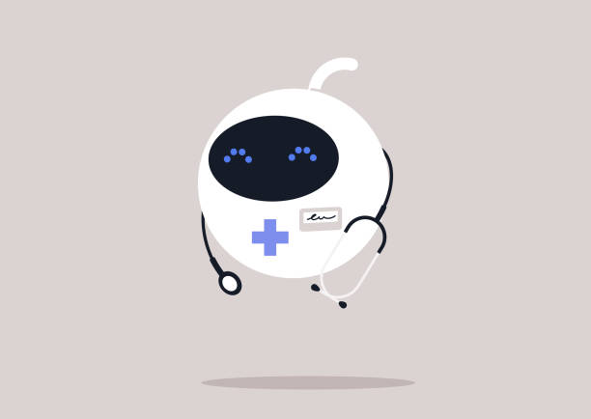

Therapist’s Assistant
Enhancing Healthcare’s Digital Front Door
Eric Braga, Fernanda Carrillo, Miguel Angel Bravo Martinez del Valle, and Riley Rutan

Slide 2
Addressing mental health challenges: Mental health challenges may be difficult to identify and have a broad impact on health, how can we help clinicians be more in tune with patients mental health needs?
Managing my Health: it's easy to get overwhelmed by all the taks patients often have to do to maintain their health, how can we make managing health more enjoyable?
Cultural Competence in Healthcare: How can we design a mobile app that helps healthcare providers better understand and respect cultural differences, improving communication and care for diverse patient populations?

Slide 3
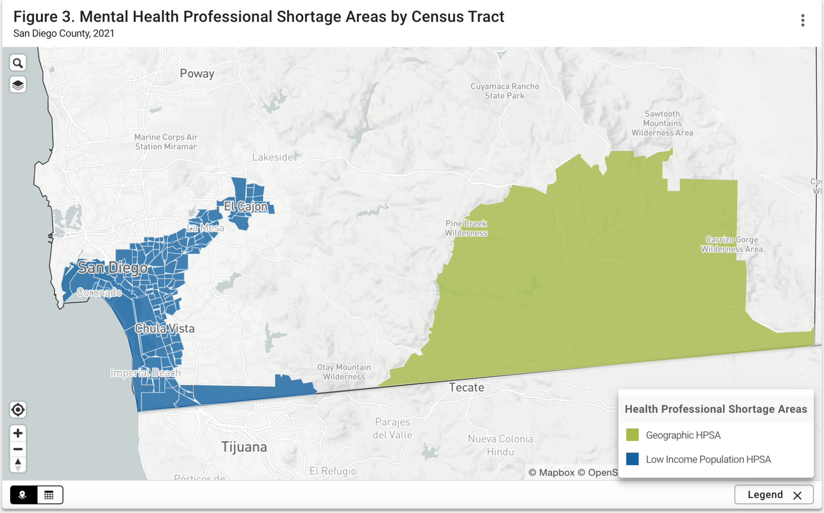
Problem Statement
San Diego County is facing a shortage of Mental Health Professionals
https://data.sandiegocounty.gov/stories/s/Health-Professional-Shortage-Areas/y4ij-rbu7/#:~:text=For%20dental%20healthcare%2C%20there%20were,with%20the%20most%20extreme%20need
Notes:
Census track showing areas with mental health professinals shortage in san diego

Slide 4
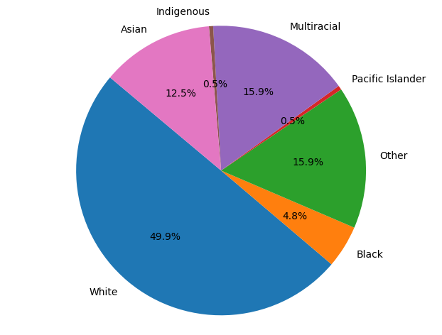
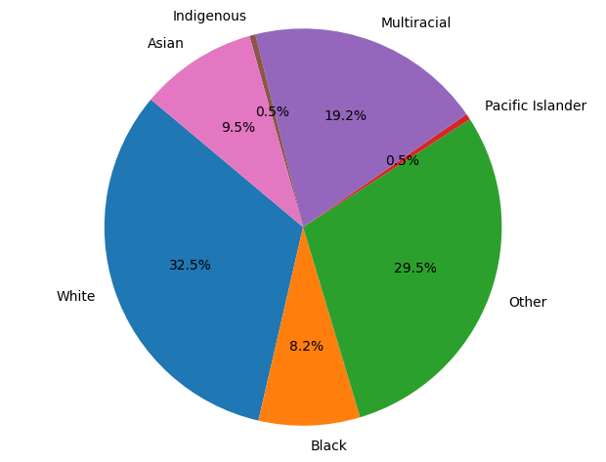
Problem Statement
Demographics of Tracts with Mental Health Professional Shortage in SD County
Demographics of SD County
Notes:
Demographics of san diego,

Slide 5
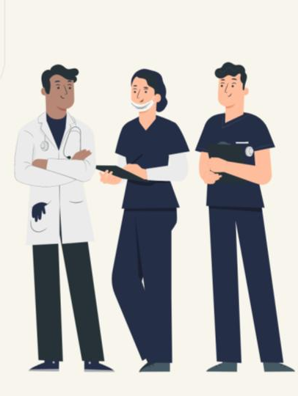
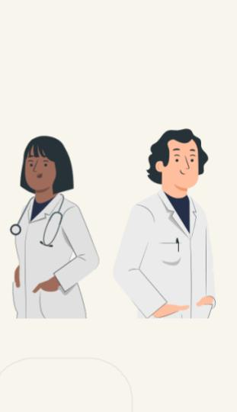
Our Solution: Therapist’s Assistant
We propose a personalized AI powered chatbot that allows patients to log their thoughts and feelings on a daily basis. How it works:
Therapist Input:
The mental health professional provides the Assistant with relevant information and personalized recommendations for the patient.
Patient Interaction (Multilingual Support):
The Assistant utilizes the therapist’s insights to provide the patient with prompts in their preferred language, encouraging adherence to recommendations and reflection on their mood and well-being.
Conversation Summarization:
The Assistant summarizes the conversation and sends it back to the therapist. This feature reduces the time spent on updates during sessions, enabling more focused discussions.

Slide 6
Patient Outcomes
Improve mental health monitoring
Translate communication between patient and therapist
Optimize time spent with your therapist
Increase access to resources
Streamline communication with therapist
Enhance patient engagement
Increase sense of support

Slide 7
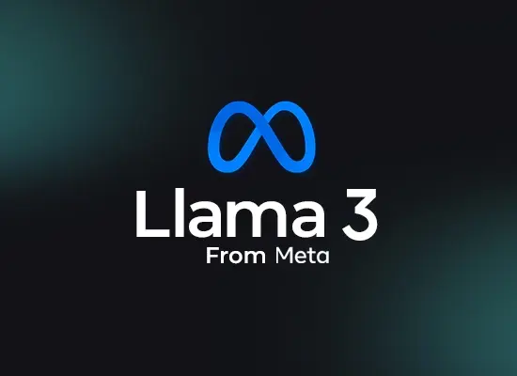



Power by Llama 3.2
State of the Art Large
Language Model
Behavior is fine-tuned through prompt engineering and model training
Free and open source for commercial use
Lightweight 1B and 3B models can be run local on mobile devices for security

Slide 8
DEMO

Slide 9
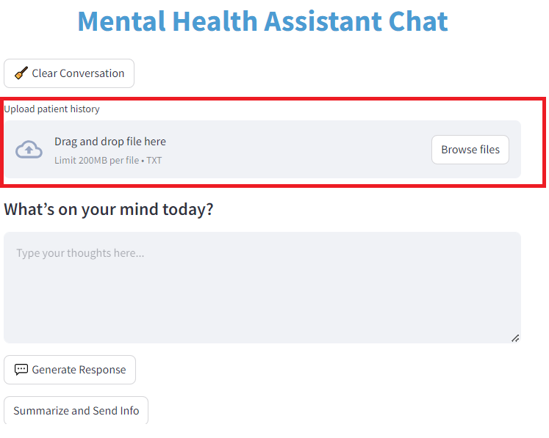

Slide 10
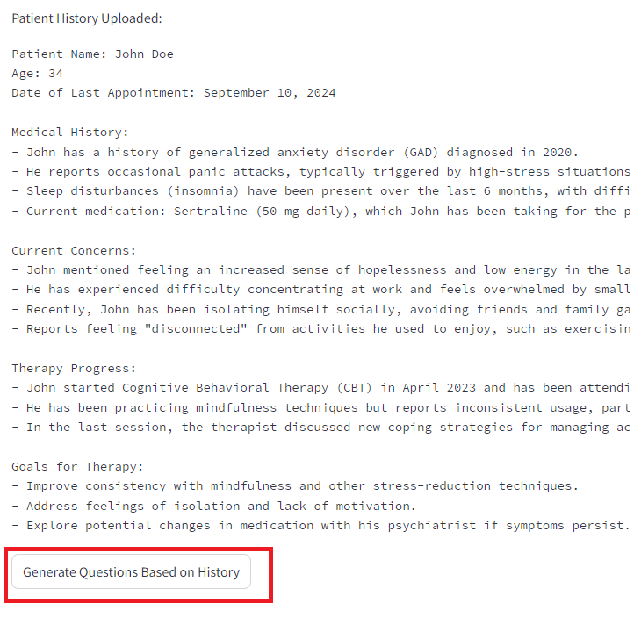

Slide 11
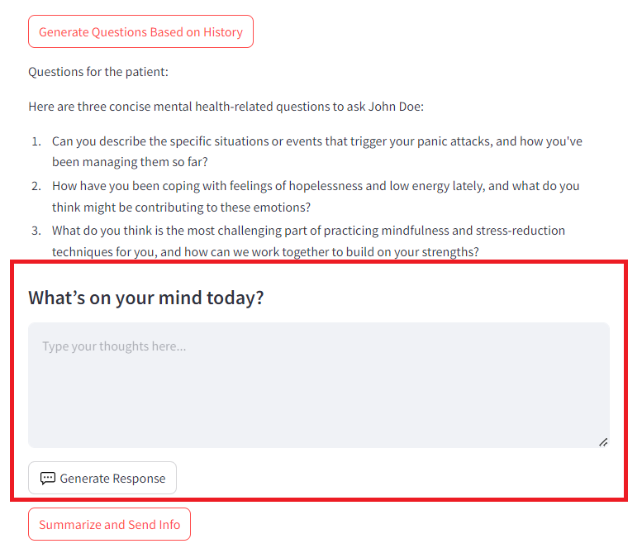

Slide 12
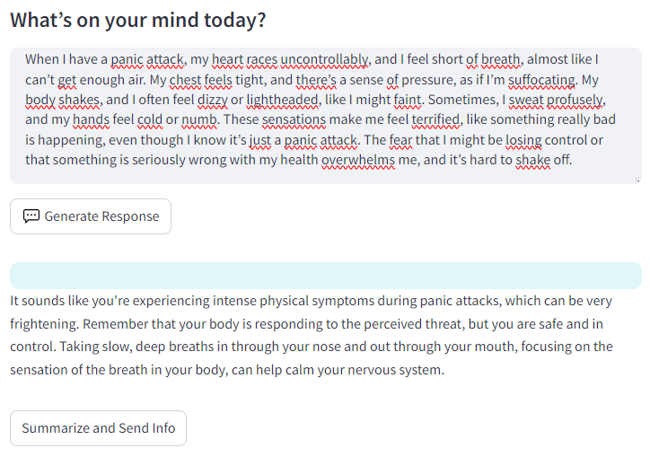

Slide 13
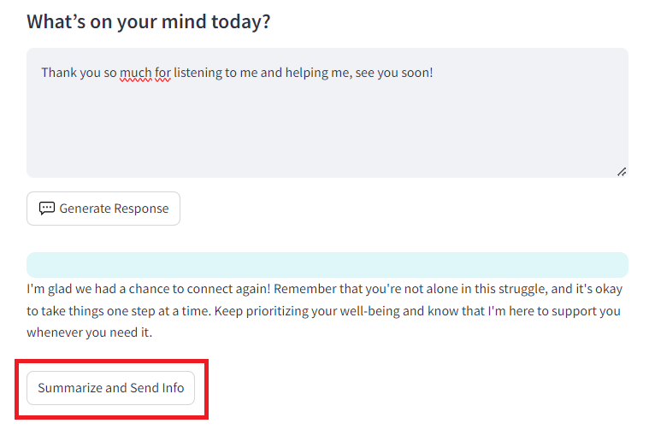

Slide 14
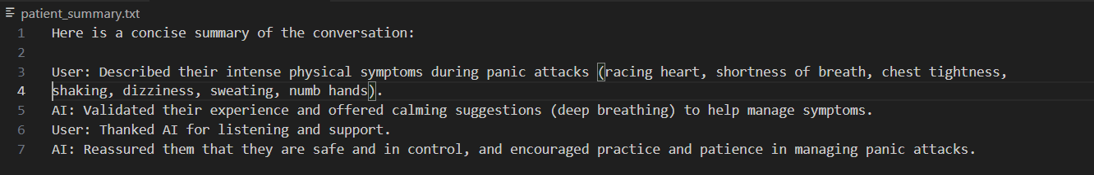

Slide 15


